Slide 1
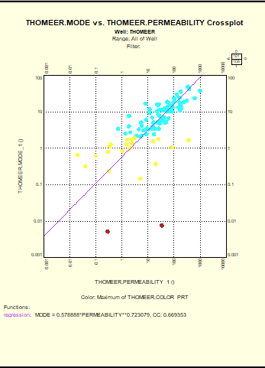
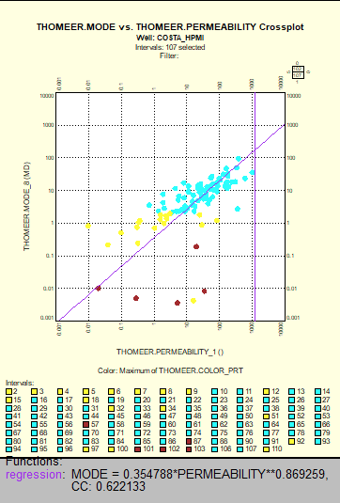
There are 2 Geolog projects:
HW
- 17 HW wells
- Thomeer well with original Thomeer results from the long file of Pc data:
- Thomeer_from_Pc_curve_fit_auto-use-picks-Auto-Put_on_GitHub-final.ipynb
Reading in the one long file of all the Pc data - Costa_core_data2.xlsx
This appears to have the best correlations???
The Thomeer well also has a few 86 element SCAL sets ???
Not right because of uneven Pc columns per sample
There is also a Pc set from the long xlsx file of Pc data
The Thomeer set is from the above mentioned xlsx file and has the best correlations
Costa_SCAL_HPMI
Thomeer set from Thomeer Analysis of SCAL set with 118 element Pc data done right.
SCAL Set is correct. Used pandas with merge and transform functions to prepare for Geolog
Two Primary Workspaces:
- Pc_Column – works from the long Pc Column set
- Costa_HPMI works from SCAL Set with 118 element arrays that are correct.
- perm to Mode correlation is not great

Slide 2
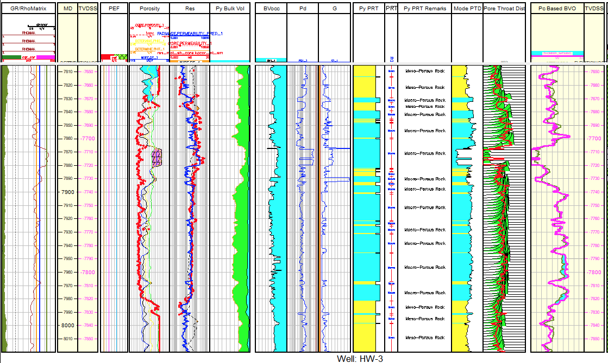
Well Logs Saturations Thomeer Parameters and PRT Pc Pc Saturations

Slide 3
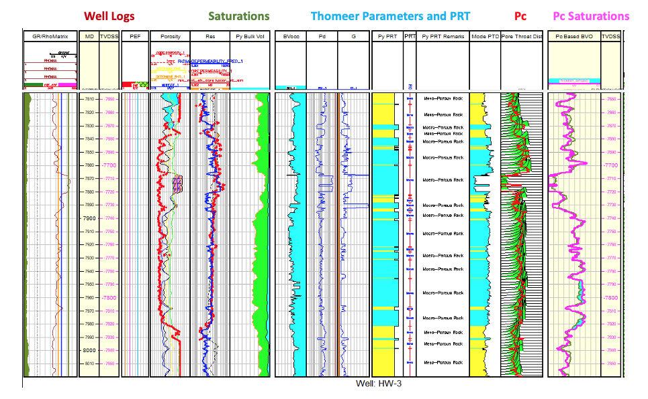

Slide 4
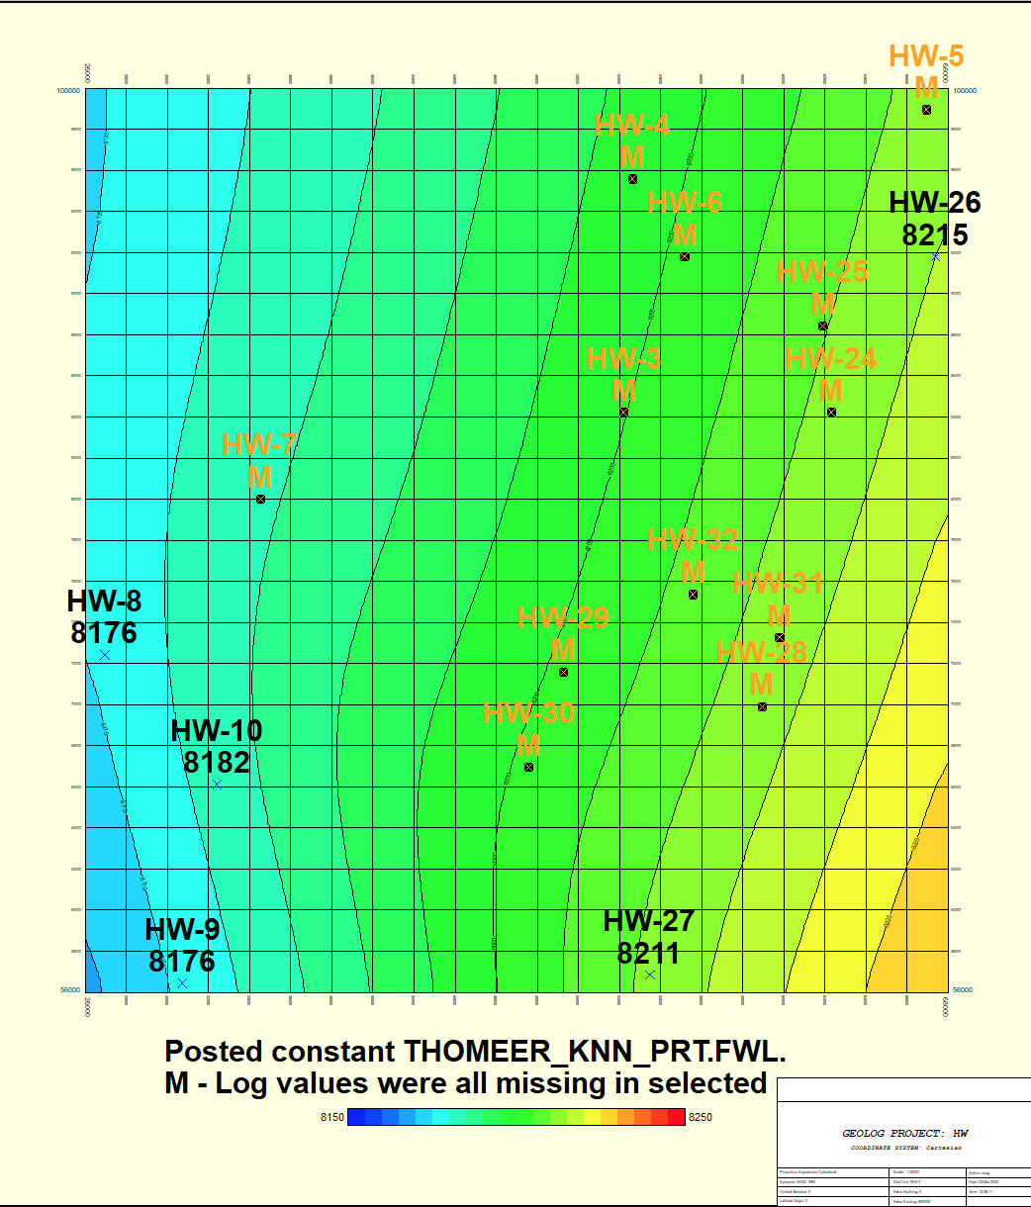
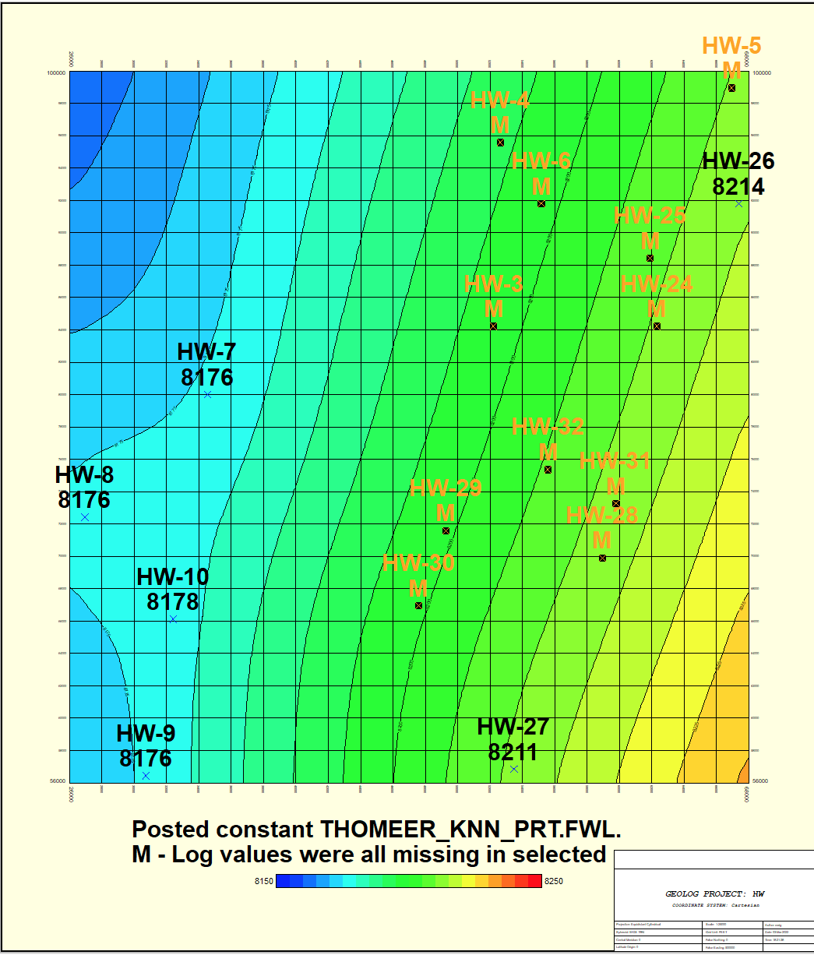

Slide 5
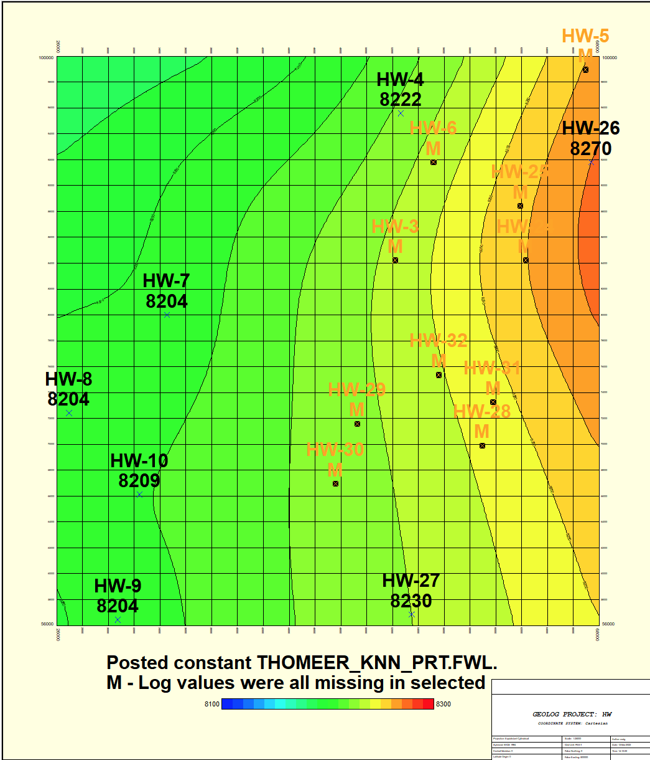

Slide 6
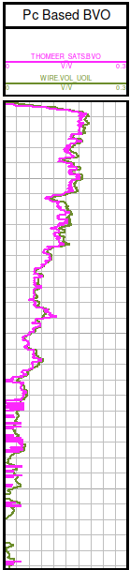
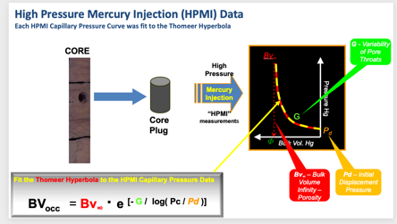
Thomeer Used to Calculate Capillary Pressure BVO
h = (fwl - tvdss) # Height above FWL
PcRes = h * 0.433 * (rho_f - rho_hc) # Pc Reservoir
PcHg = 367 * (PcRes / tcosthetaww) # Pc Reservoir converted to Pc Mercury
BVO
Logs
# Calculate Bulk_Volume_Occupied for up to 2 pore systems at each well-level
bvocc₁ = bv₁ * 10**(-0.434*G₁ / log10(PcHg / Pd₁))
bvocc₂ = bv₂ * 10**(-0.434*G₂ / log10(PcHg / Pd₂))
bvo = bvocc₁ + bvocc₂
BVO
Thomeer

Slide 7
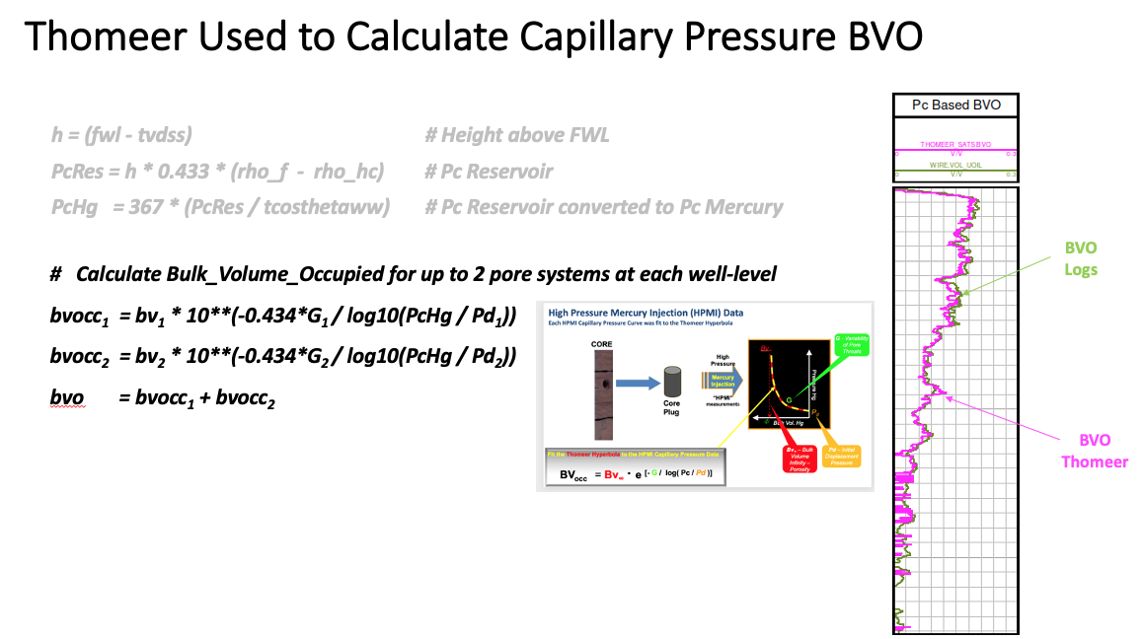

Slide 8
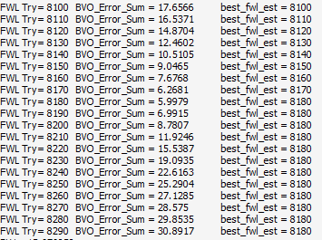

Slide 9
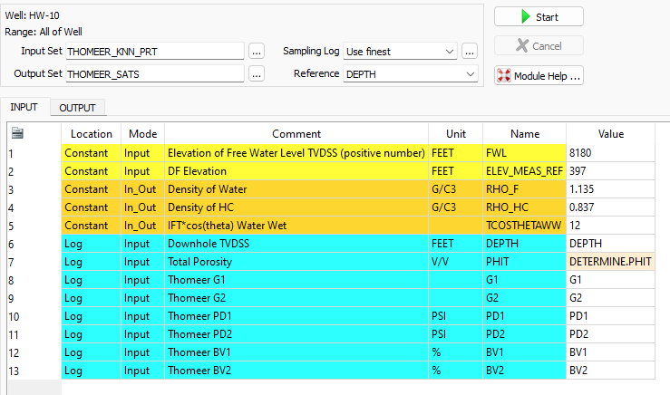

Slide 10
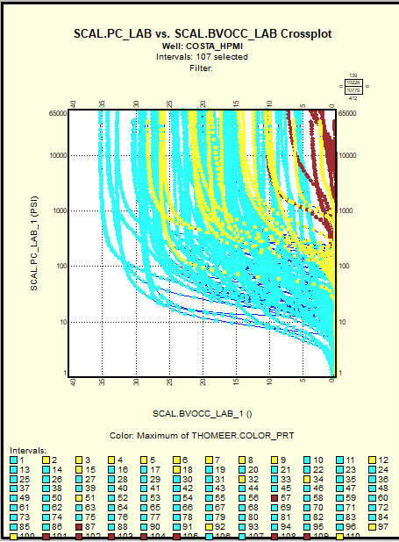

Slide 11
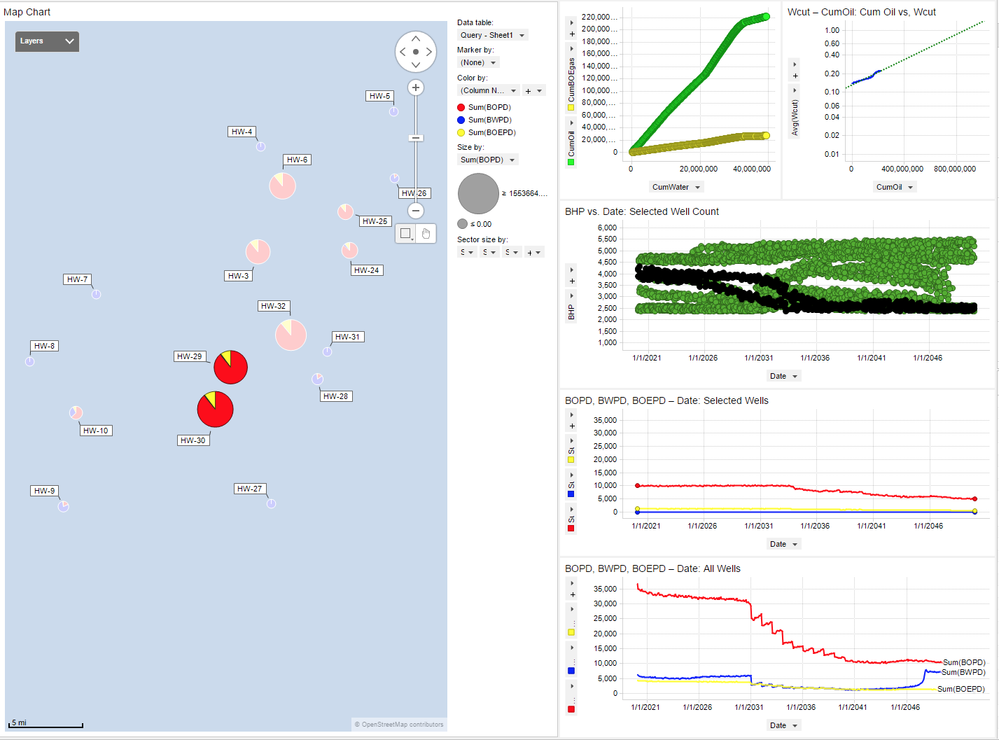

Slide 12
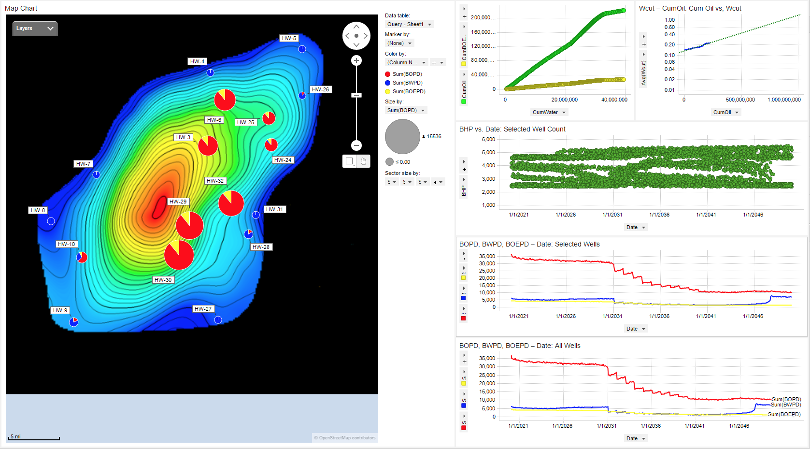

Slide 13
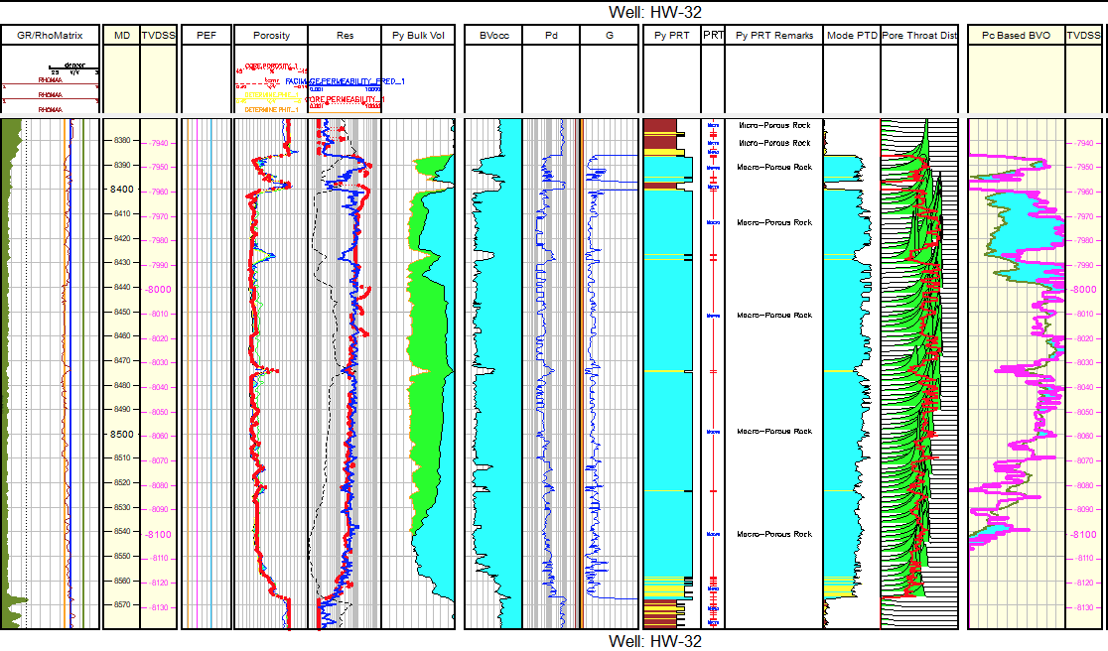

Slide 14
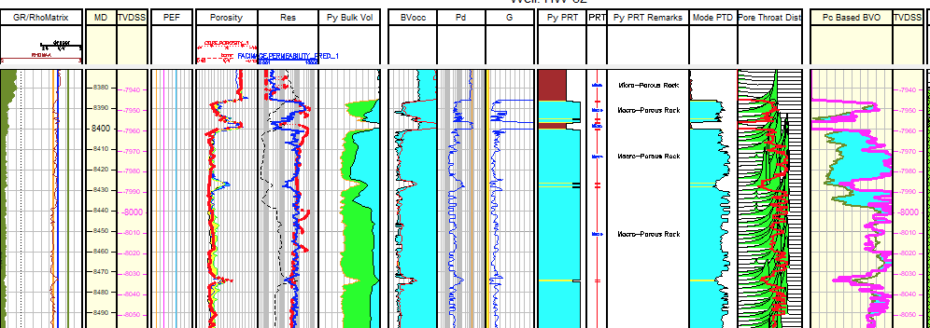

Slide 15
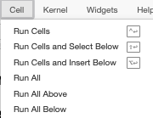
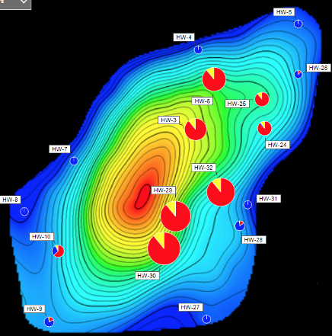

Slide 16
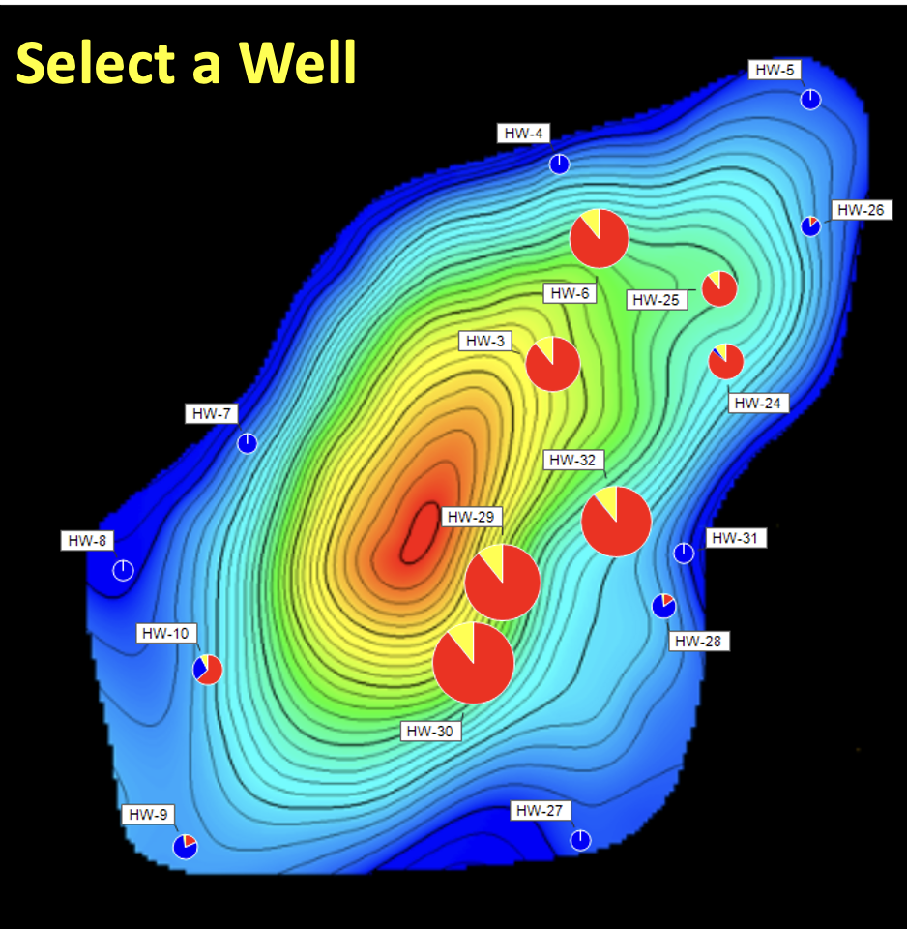

Slide 17
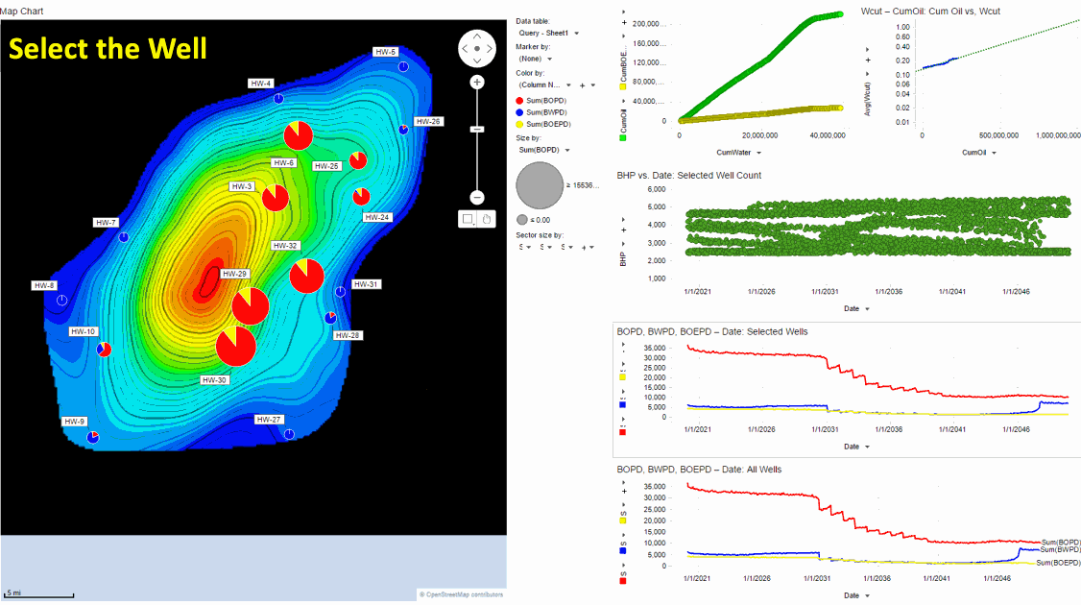

Slide 20
Select a Well
Dynamic Data

Slide 21
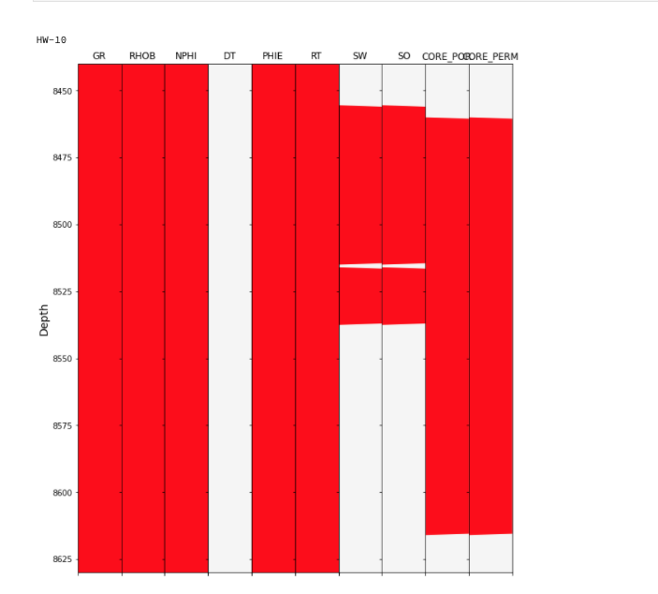
Load las files and plot extent of log data in each las file per Andy McDonald
Thanks Andy!

Slide 22
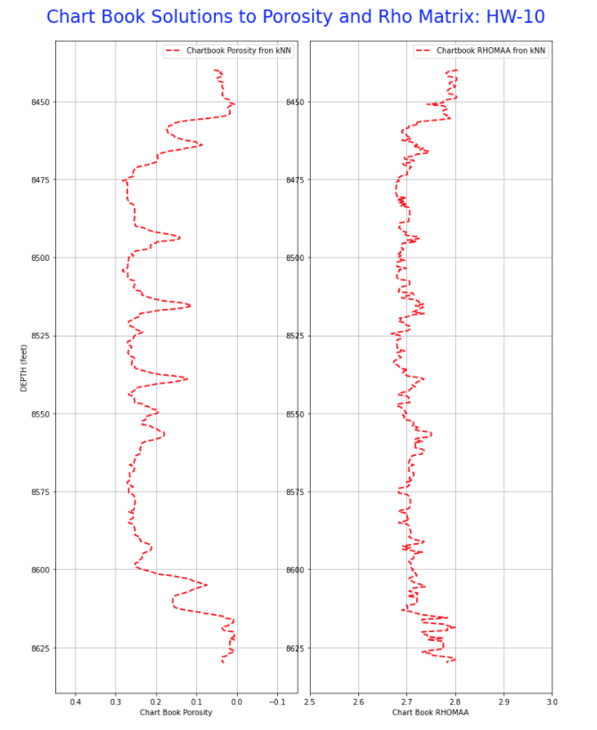
Rho Matrix
PHIT

Slide 23
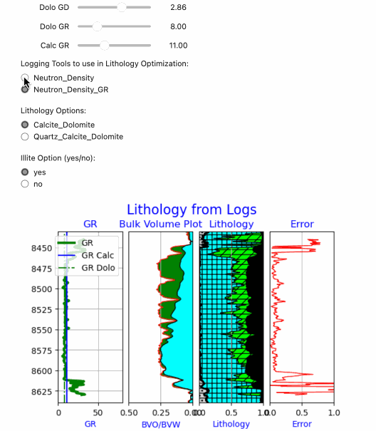
Interactive Lithology Optimization with with Real-Time Sliders and Checkboxes

Slide 24
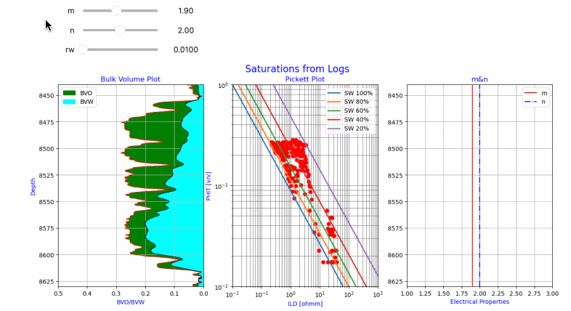
Electrical Property Refinement using a Pickett Plot with Interactive Sliders

Slide 25
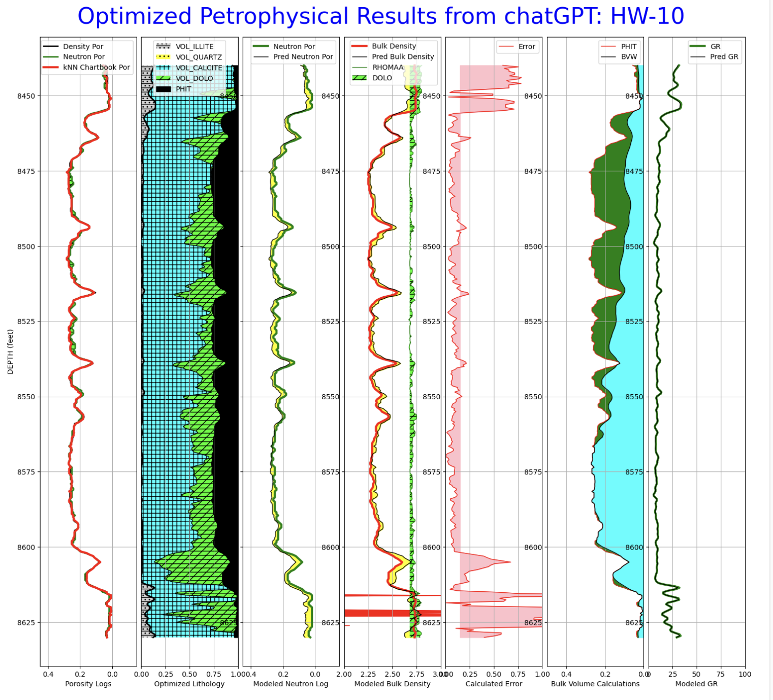
Saturations
SciPy
Optimized
Lithology

Slide 26
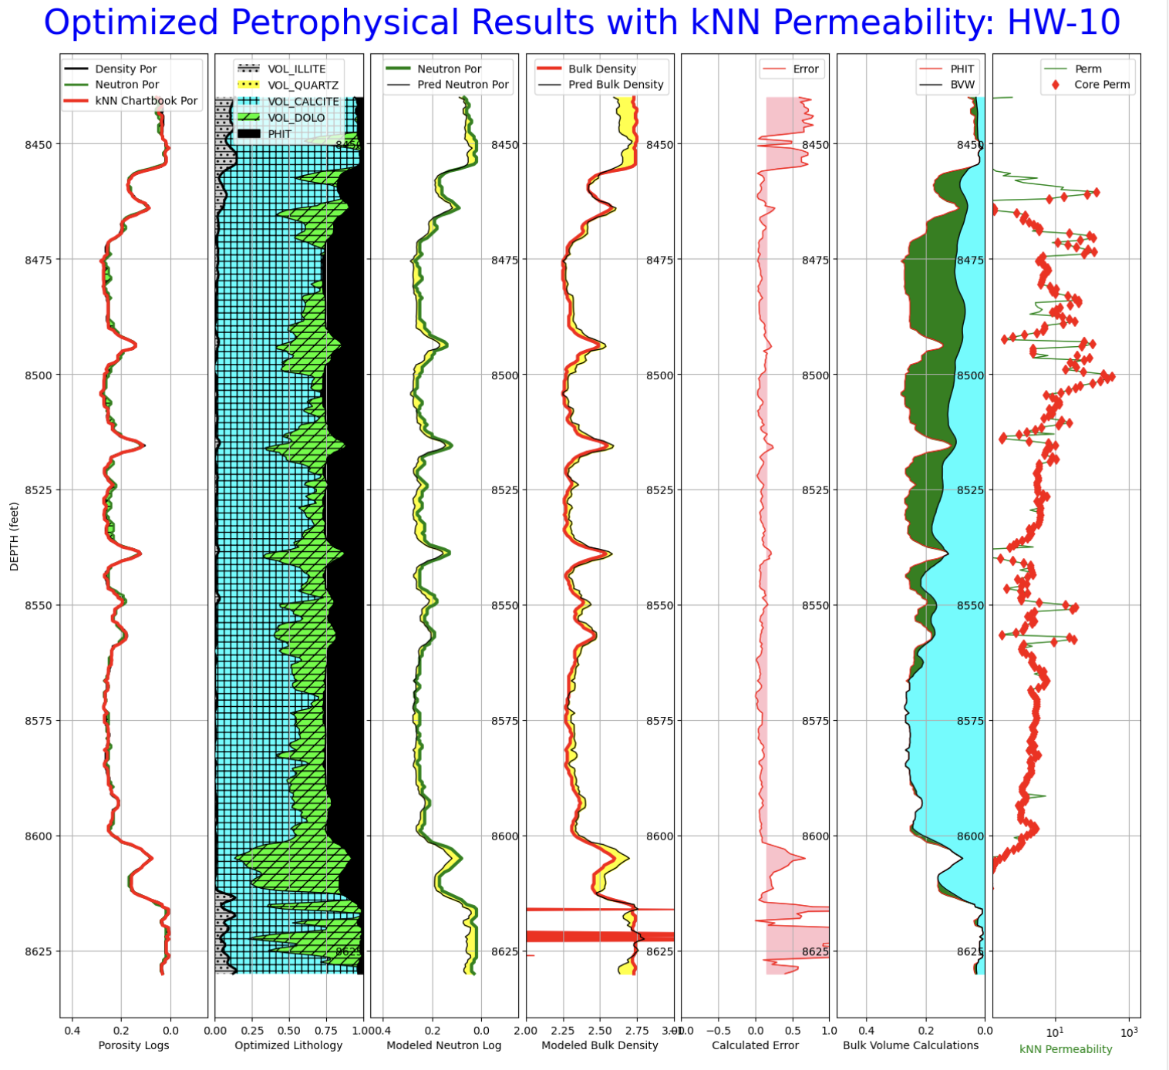
Perm kNN
Core
Permeability

Slide 27
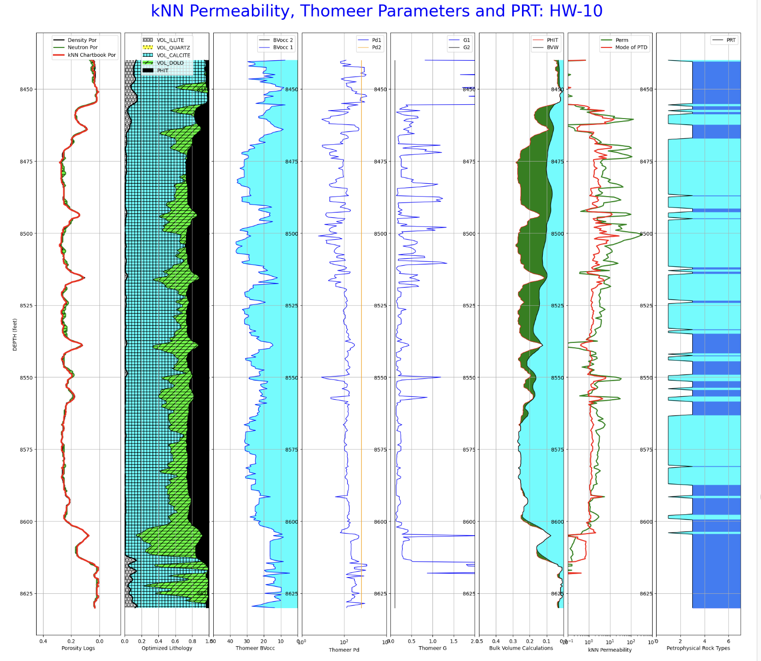
Thomeer Parameters
PRT

Slide 28
Free Water Level Search Results for a Single Well

Slide 29
Free Water Level Search Results for Field

Slide 30
Thomeer Used to Calculate Capillary Pressure BVO
h = (fwl - tvdss) # Height above FWL
PcRes = h * 0.433 * (rho_f - rho_hc) # Pc Reservoir
PcHg = 367 * (PcRes / tcosthetaww) # Pc Reservoir converted to Pc Mercury
BVO
Logs
# Calculate Bulk_Volume_Occupied for up to 2 pore systems at each well-level
bvocc₁ = bv₁ * 10**(-0.434*G₁ / log10(PcHg / Pd₁))
bvocc₂ = bv₂ * 10**(-0.434*G₂ / log10(PcHg / Pd₂))
bvo = bvocc₁ + bvocc₂
BVO
Thomeer

Slide 31
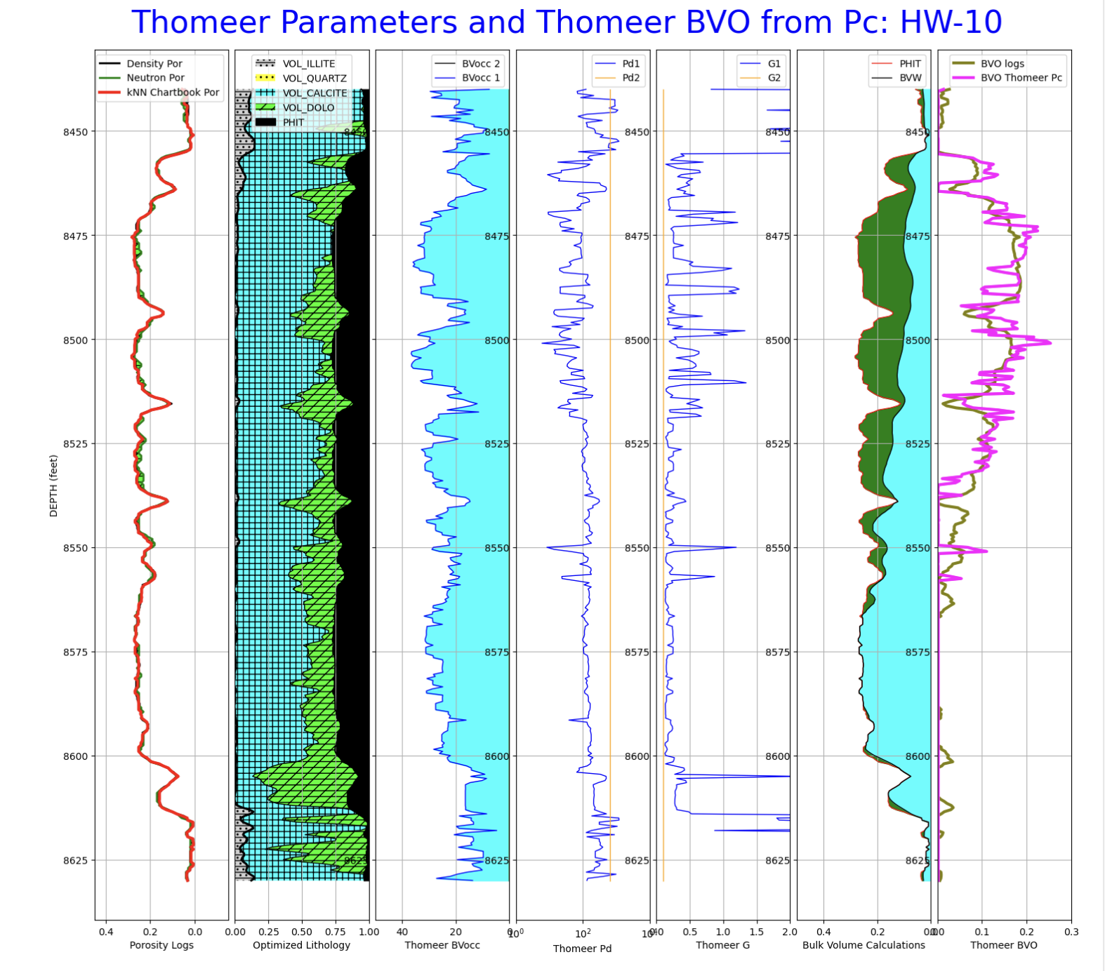
BVO
Logs
BVO
Thomeer

